Slide 1
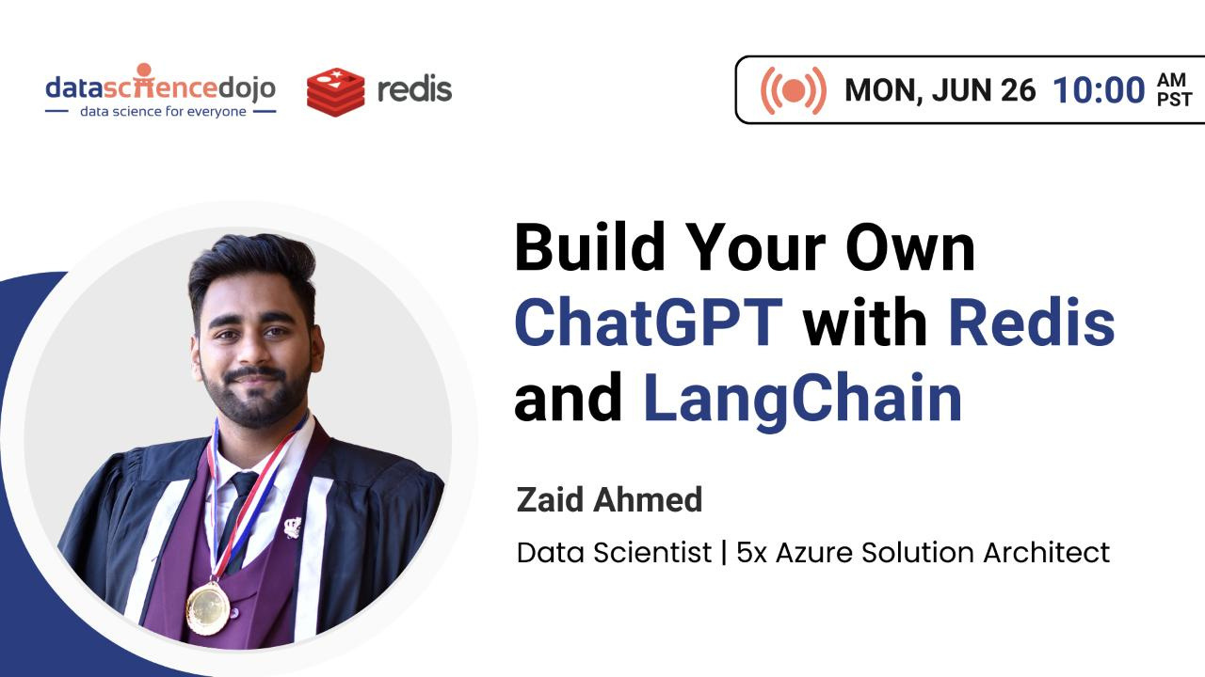

Slide 2

Agenda
A short history of evolution of ChatGPT
Why Langchain is required?
What are Vector Databases?
How to utilize Redis as a vector database?
Architecture of Chatbot
Demo: Build end-to-end apps with Redis and Langchain
Deployment: Deploy your app on Streamlit cloud

Slide 3
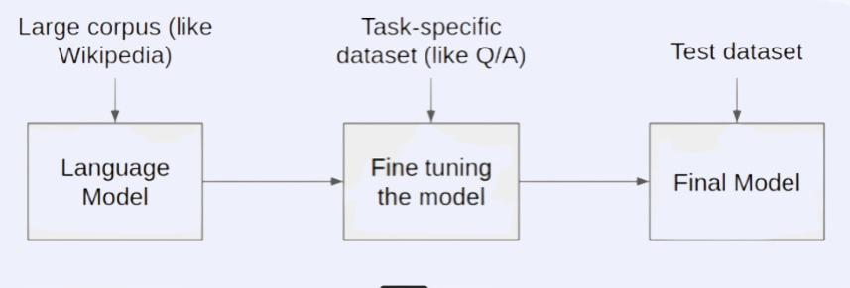
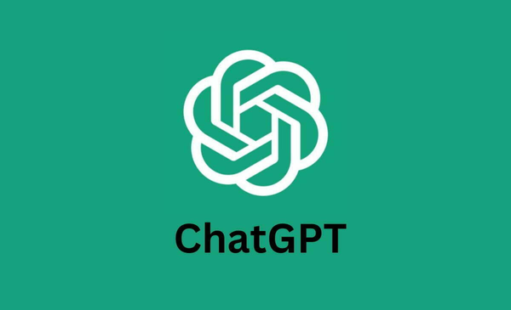
Before we begin...
A Short History Of ChatGPT(Generative Pre-trained Transformer)
One of the first pre-trained language models was the Transformer, developed by Google in 2017. This model used a neural network architecture which designed to understand natural language in context and produce accurate and useful responses.

Slide 4
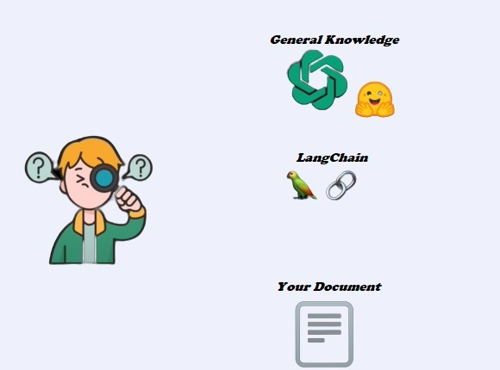
Why Langchain?
Langchain is an Orchestration
Tool which helps ChatGPT to efficiently response according to your corpus of data.
It orchestrates the context along with the query to the OpenAI model.

Slide 5
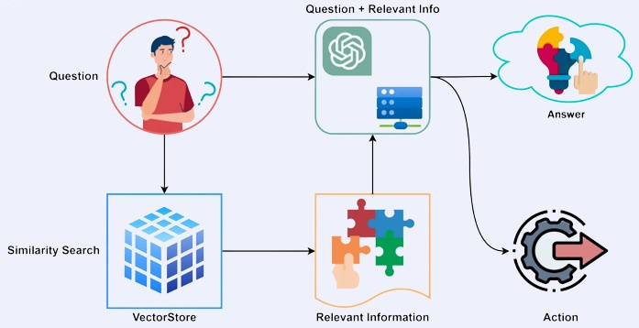
Why should I use these tools?

Slide 6
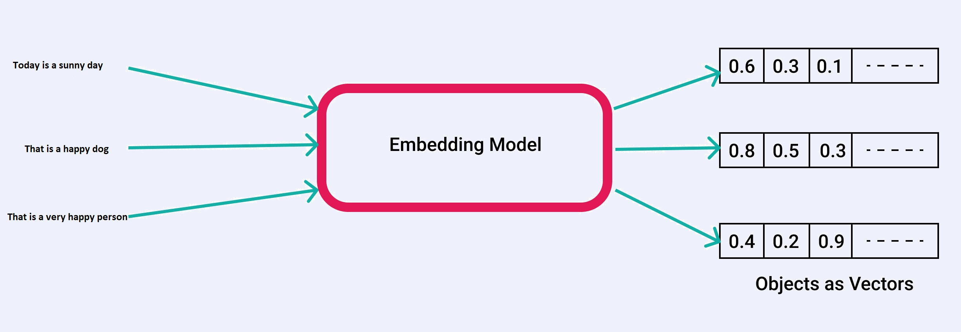
Vector Embeddings

Slide 7
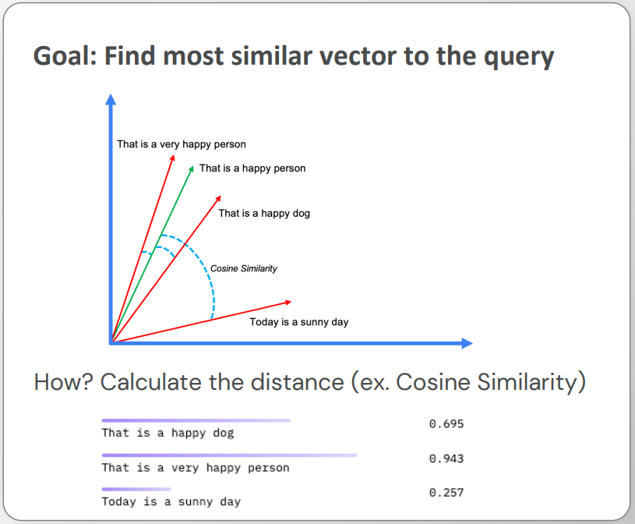
Vector Similarity Search
Source:https://partee.io/2023/04/13/23-LLM-in-prod-talk/

Slide 8
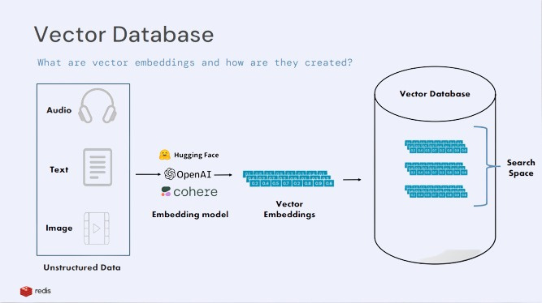
Source:https://partee.io/2023/04/13/23-LLM-in-prod-talk/

Slide 9
Pre-requisites
Dependencies
Github repo link -> https://github.com/mrzaid
Install Docker desktop
Create Redis Database using docker image
docker run -d --name redis-stack-server -p 6379:6379 redis/redis-stack-server:latest
Clone the github Repo
Follow the steps mentioned in Readme file
Create a subscription on Streamlit Cloud to deploy the app.

